Slide 1

WALMART BIG DATA PROJECT
GROUP 6: Roshan, Gangothri, Narendra, Chandan, Faryar

Slide 2
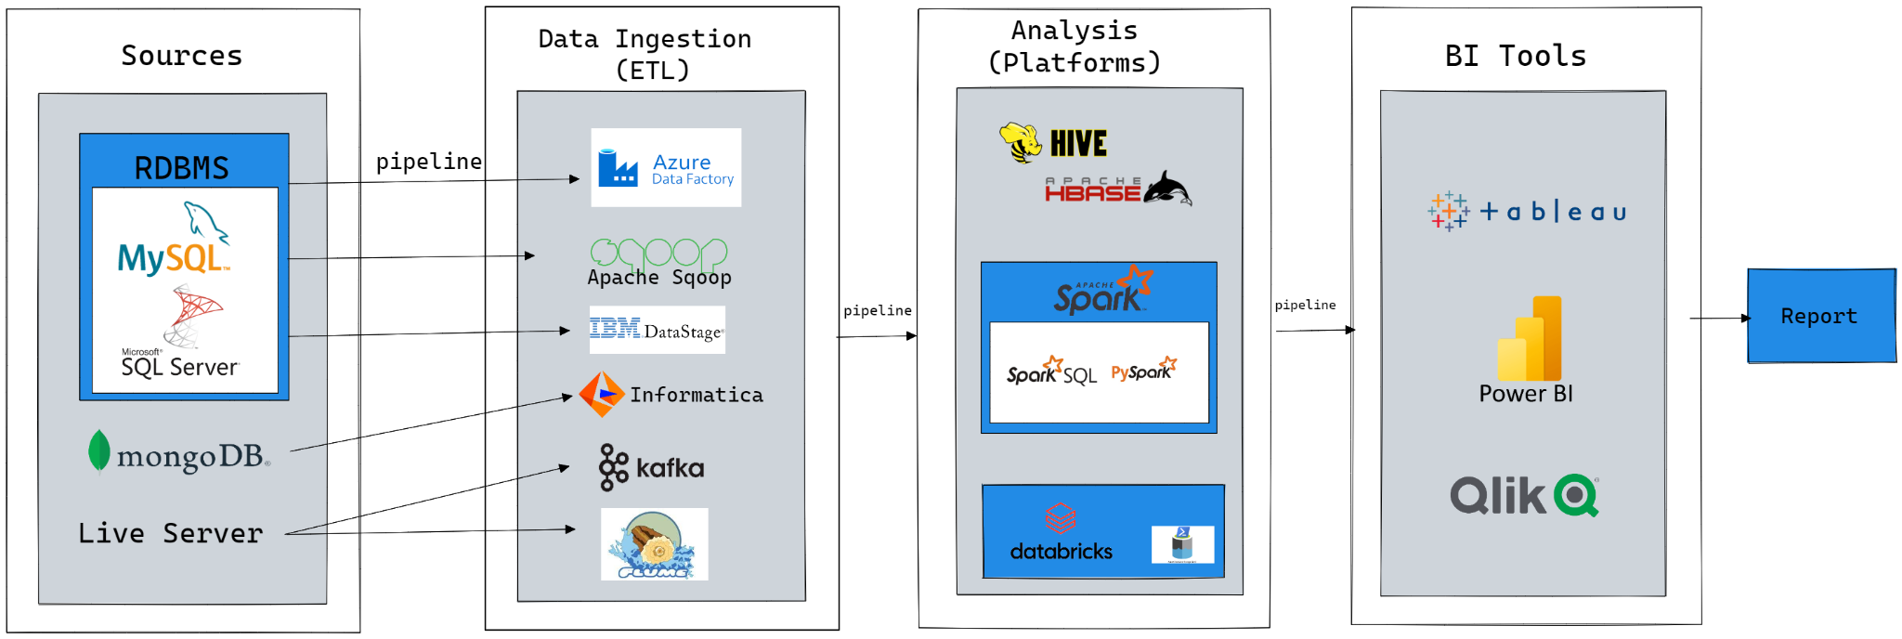
Big Data Architecture

Slide 3
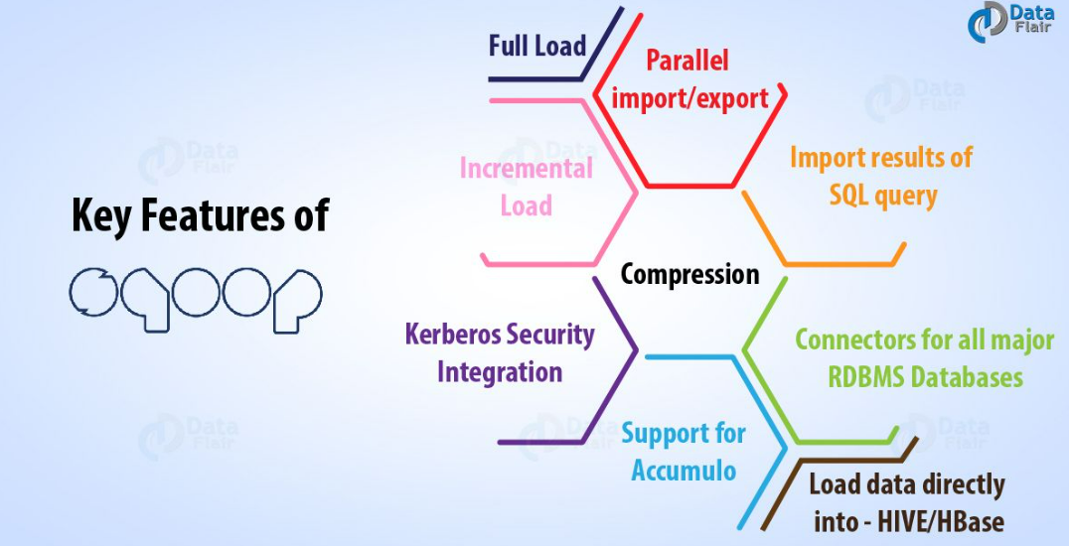
Apache Sqoop Key Features

Slide 4
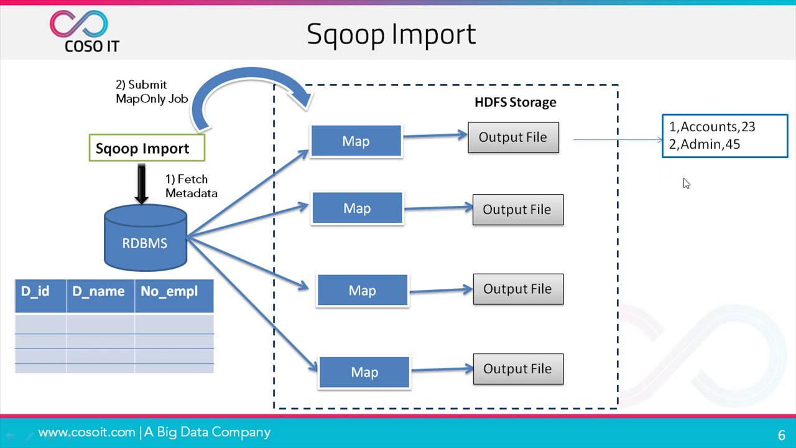
Apache Sqoop WorkFlow

Slide 5

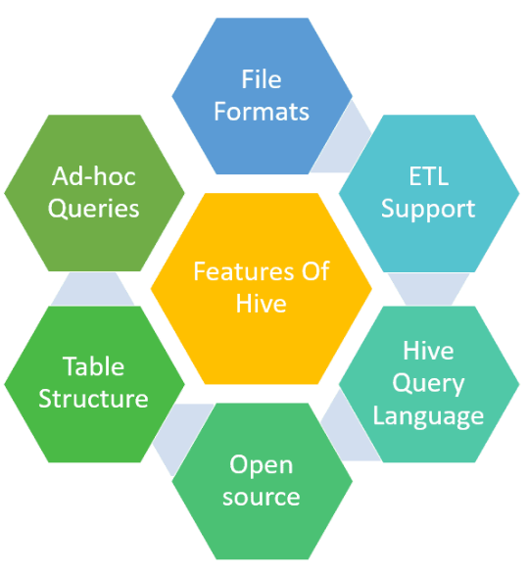
What is Hive?
Apache Hive is often referred to as Data Warehousing infrastructure tool which is developed on the top of Hadoop file distributed system, used for processing and analysing large volume of structured, semi-structured data using Hive Query Language (HQL)

Slide 6
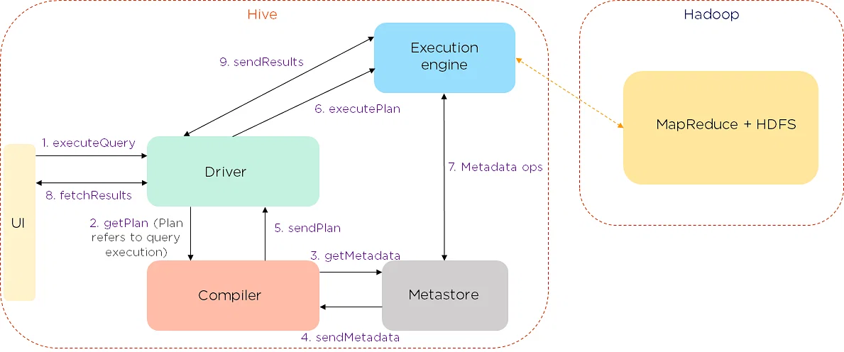
Hive Architecture

Slide 7
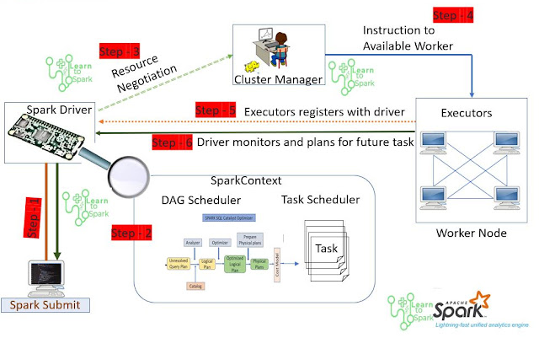
Apache Spark Job Execution

Slide 8



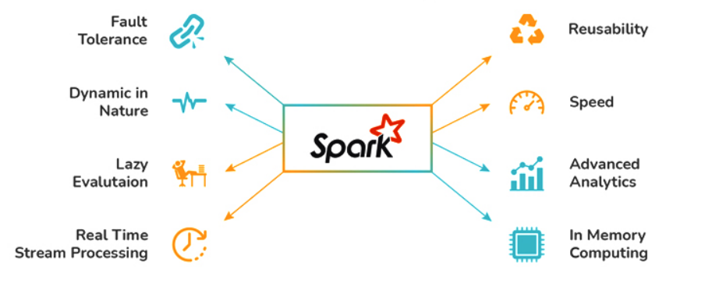
Apache Spark Key Features

Slide 9
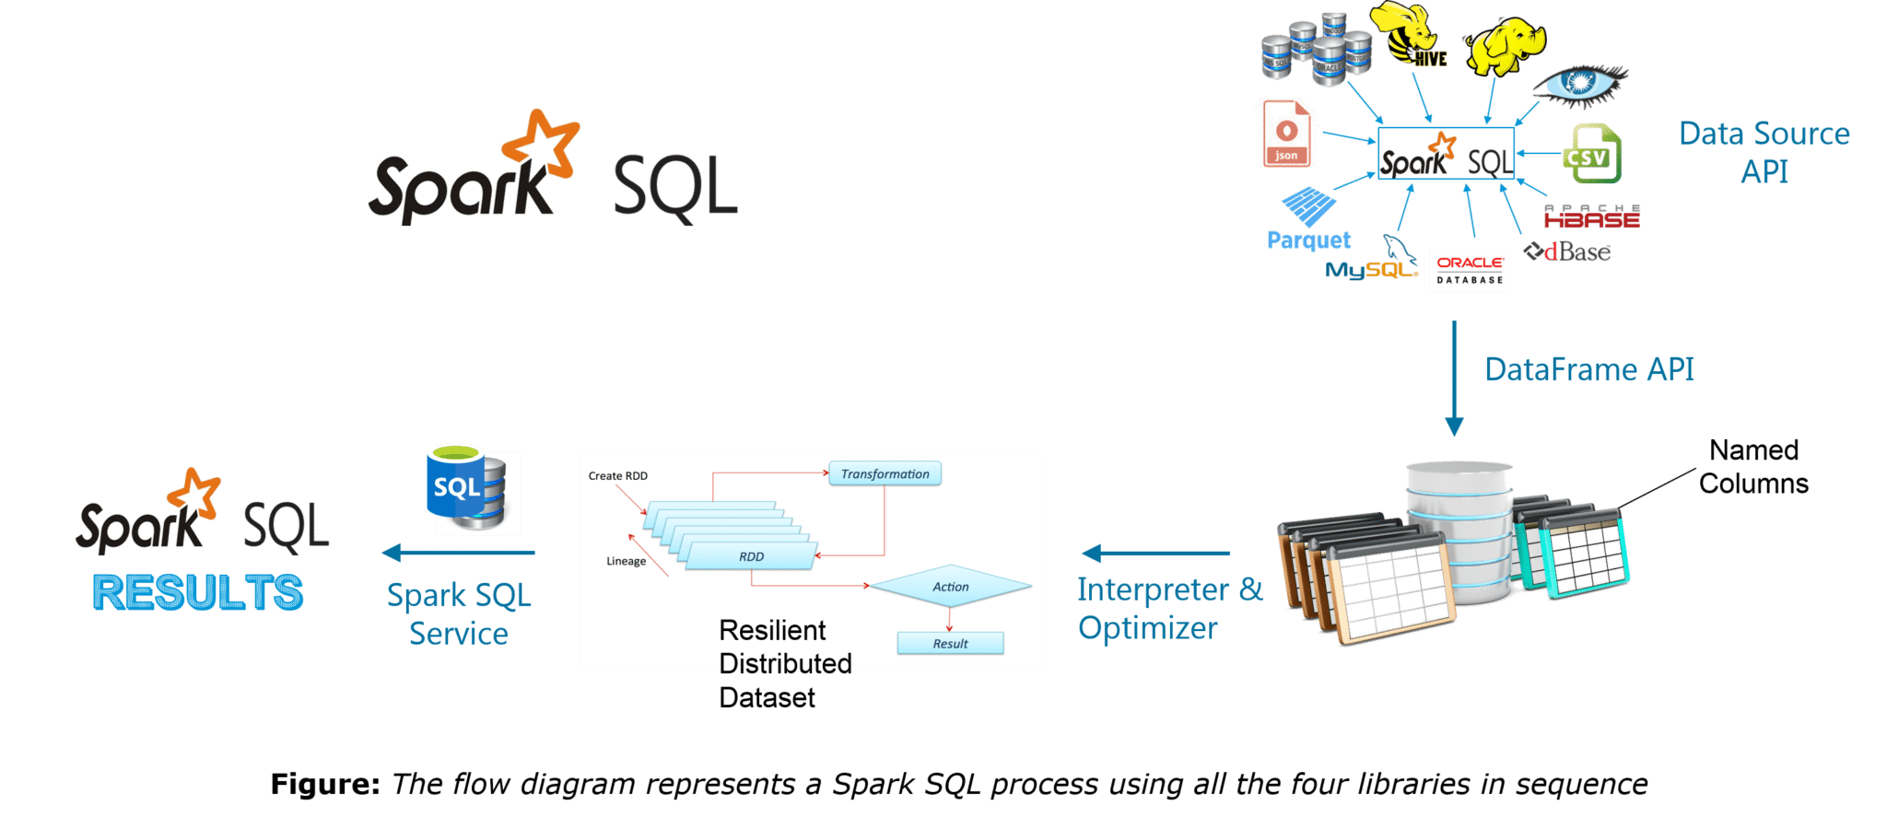
Spark SQL Pipeline
Notes:
Spark SQL - library built on top of Spark Core Execution Engine - uses JDBC/ODBC driver for executing SQL queries

Slide 10
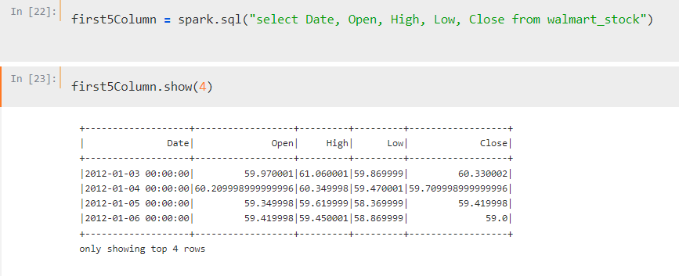
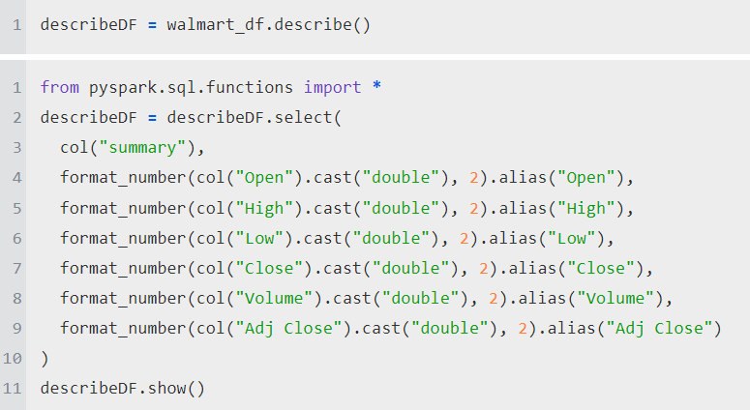
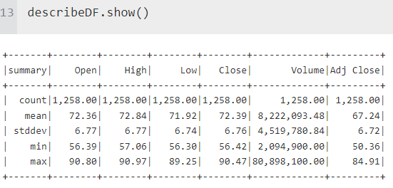
Scenario 01: Print out first 5 columns
Scenario 02: Describe function, formatted to two decimal place

Slide 11
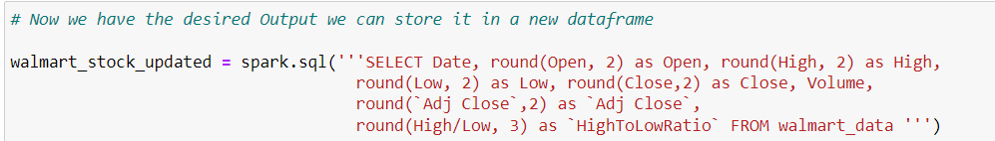
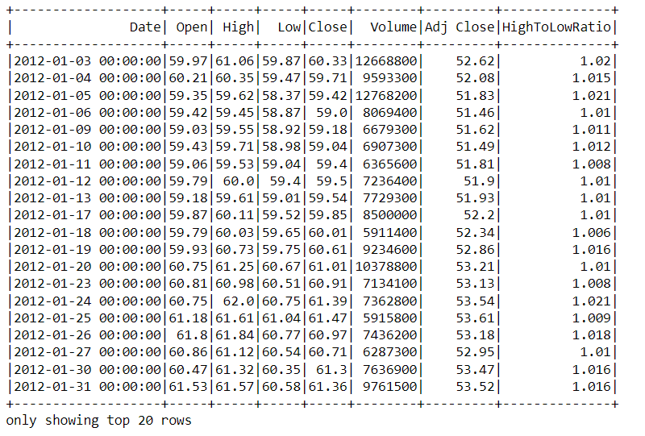
Scenario 03: Create a new dataframe with a column called HighToLow Ratio that is the ratio of the High Price versus Low Price of stock traded for a day

Slide 12
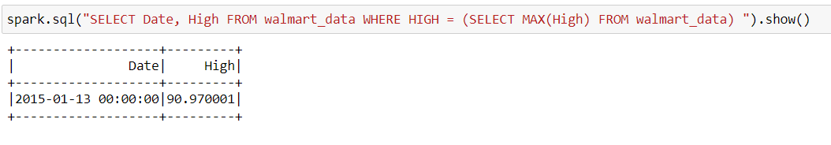
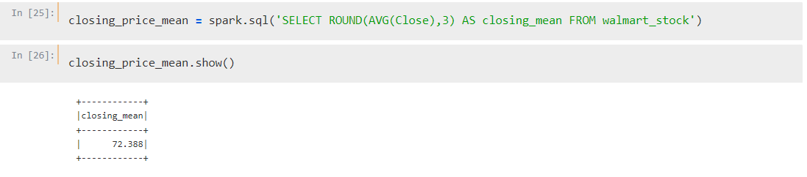
Scenario 04: What day had the Peak High in Price?
Scenario 05: What is the mean of the Close column?

Slide 13
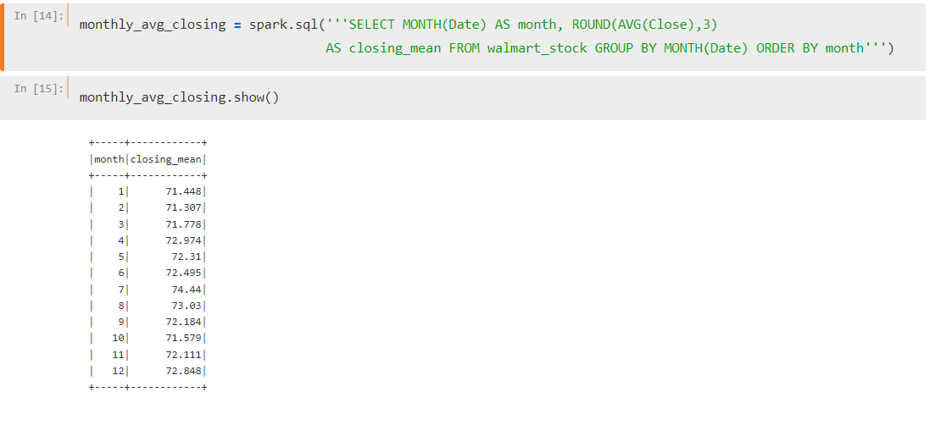
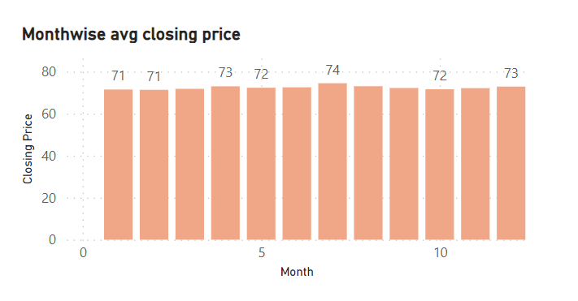
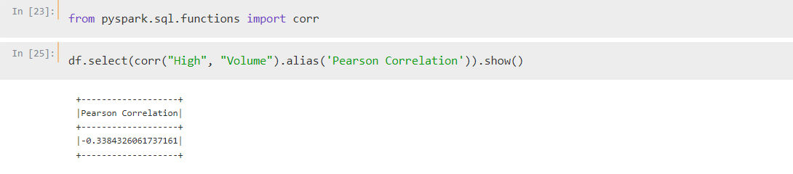
Scenario 10: What is the average Close for each Calendar Month?
Scenario 11: What is the Pearson correlation between High and Volume?

Slide 14
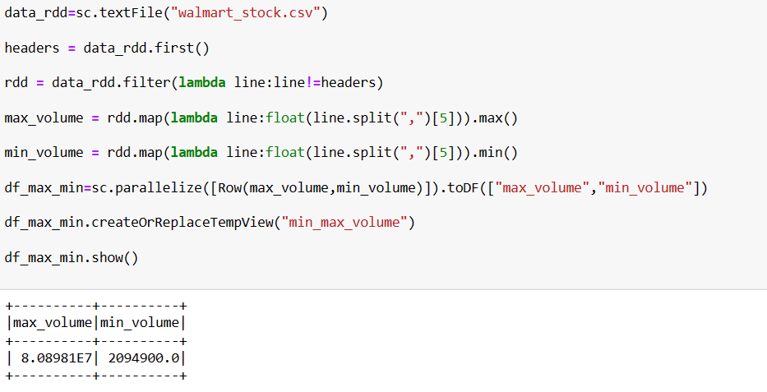
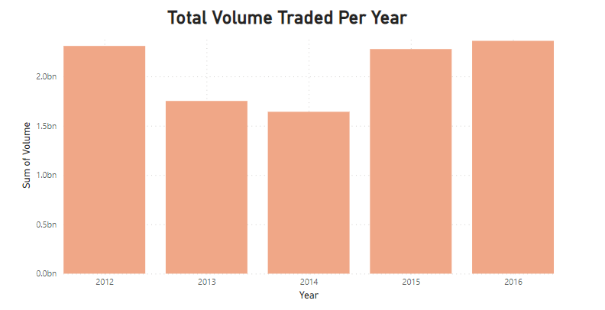
Scenario 06: What is the max and min of the Volume column?

Slide 15
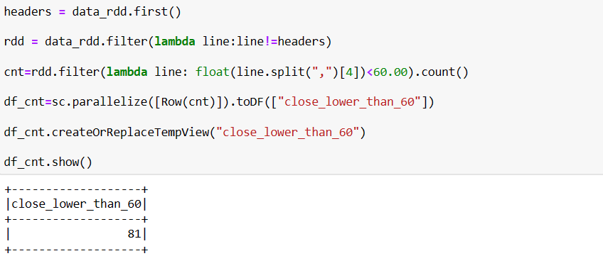
Scenario 07: How many days was the Close lower than 60 dollars?

Slide 16
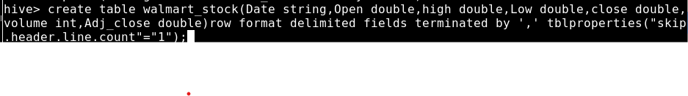
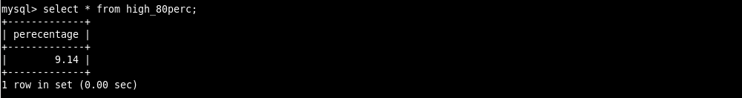
Scenario 08: What percentage of the time was the High greater than 80 dollars?

Slide 17
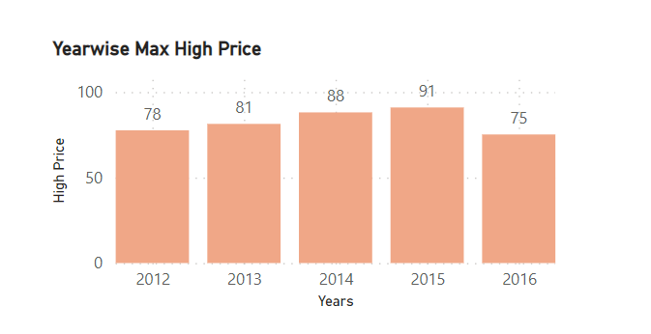
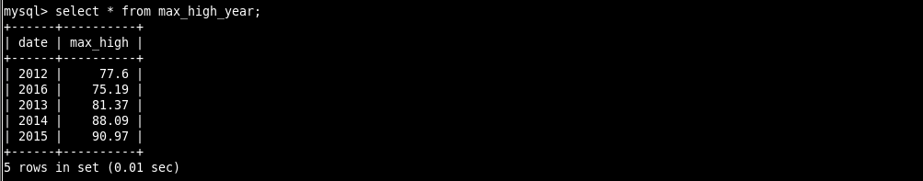
Scenario 09: What is the max High per year?

Slide 18

E-Commerce
Big Data Analysis

Slide 19
UNDERSTANDING THE E-Commerce DATA:
Dataset has duplicate values.
Data in timestamp column is not formatted as per the default format, so we will format that as well
For quantity column we have counters instead of the exact value.
For example, if a customer had bought 2 quantities of the same product we have that data in two rows, in the first row the quantity is 1 and in the second row the quantity is 2. So we will only take the row with the total quantity.

Slide 20
Hive Queries
User Story 01. The monthly trend of sales:
hive> insert overwrite table monthly_sales select year(timestamp) as years, month(timestamp) as months, sum(payment) as sales from cecom where ostatus not in ('canceled', 'unavailable') group by year(timestamp), month(timestamp) order by months, years;
User Story 04: Which hour has more no. of sales?
hive> insert overwrite table hourly_most_sales select hours, sales from (select hour(timestamp) as hours, sum(quantity) as sales, rank() over(order by sum(quantity) desc) AS `max_sales` from cecom group by hour(timestamp)) t where max_sales = 1;
User Story 03. What are the most commonly used payment types?
hive> insert overwrite table common_paymenttype select paymenttype, count(oid) as tcount from cecom group by paymenttype order by tcount desc;
User Story 04: Count of Orders With each No. of Payment Installments
hive> insert overwrite table installment_count select installments, count(oid) as tcount from cecom group by installments;

Slide 21
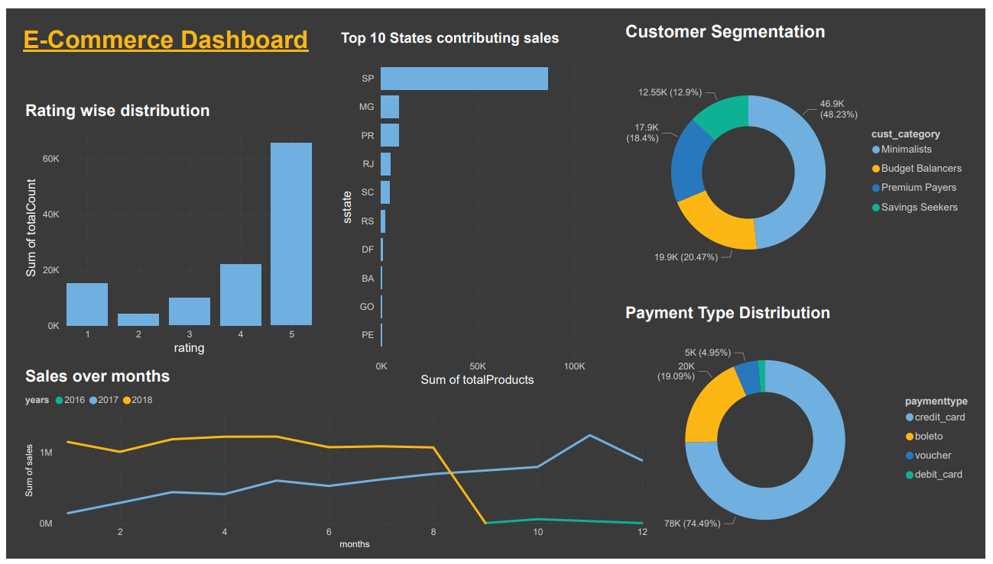
E-Commerce Dashboard

Slide 22
THANK YOU

